Slide 1
Google Dorking & Shodan
Abhishek Pandey
Exploring the world of Cyber Security

Slide 2
About Author
Diploma in Cyber law
Social engineering
OSINT
Digital Forensics
Red teaming
Numismatics

Slide 3
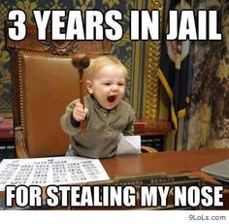
First Things First
Is it legal?
Are we doing anything wrong?
What to expect at the end?
“we will search for vulnerable server and user, and will not exploit it”
www.routerpasswords.com
Notes:
Warning sign, default password

Slide 4
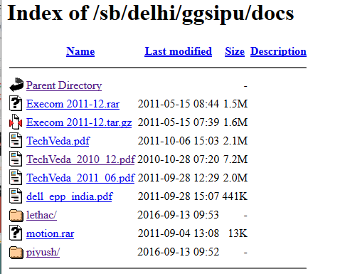
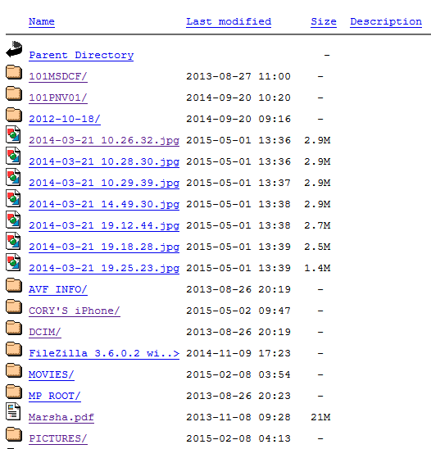
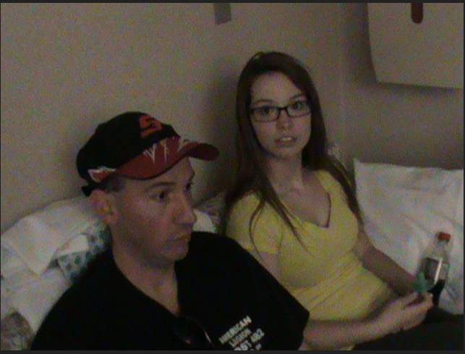

Slide 5
Content
Part 1: Google Hacking
Basic of google
How does google work
Advance operator
Hacking Basics
Document Grinding
Hacking Google services
How to protect yourself
Part 2: Shodan
Basic of shodan
How does shodan work
...many more

Slide 6
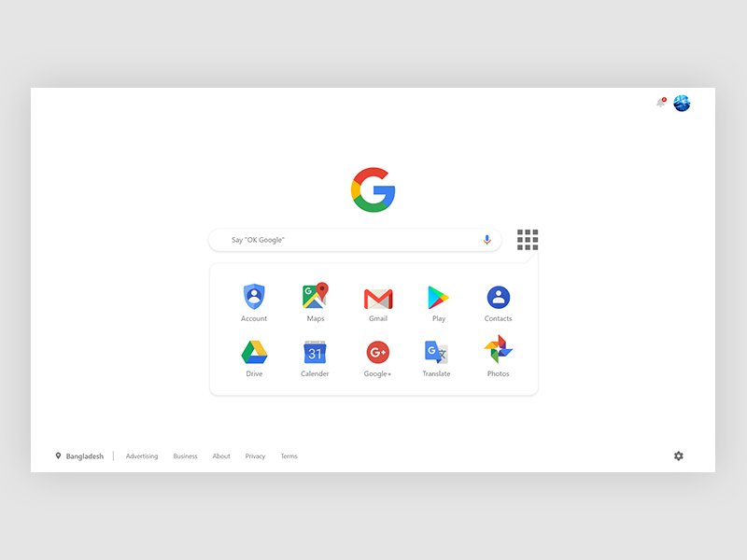

Slide 7
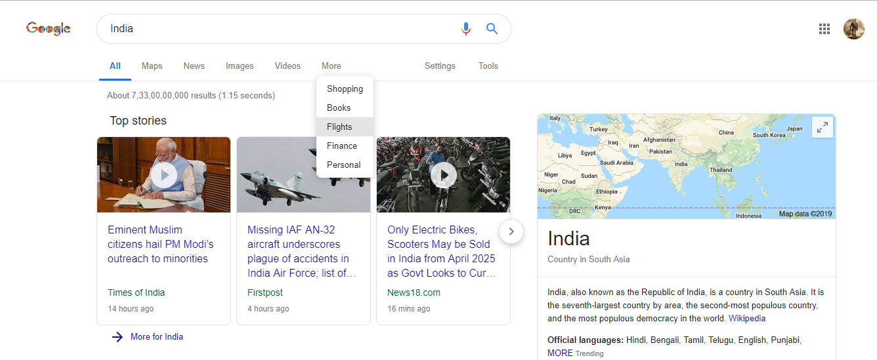

Slide 8
Why?
User
Hacker
Notes:
User ⇒ Easy life, story of Amish

Slide 9
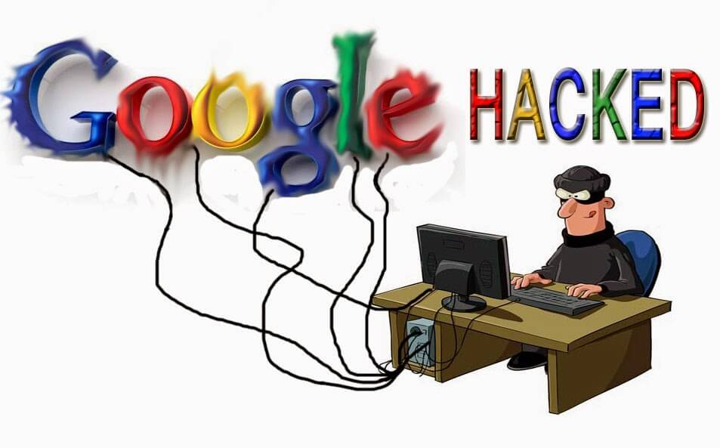

Slide 10
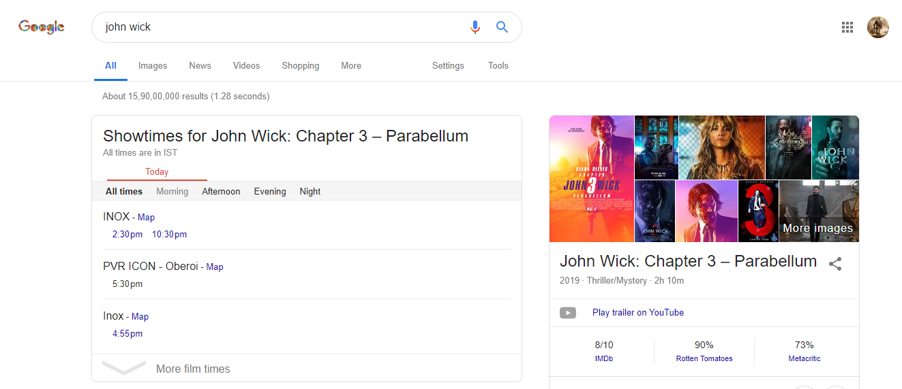
https://www.google.com/search?newwindow=1&rlz=1C1CHBF_enIN845IN845&biw=1366&bih=576&ei=si32XPPcHaO1mgf9qryADA&q=john+wick&oq=john+w&gs_l=psy-ab.1.0.0i131l7j0j0i131l2.1797.3973..6138...0.0..0.674.1680.0j4j4-1j1....2..0....1..gws-wiz.......0i71j0i67j0i131i67.2NEATCbAE1I

Slide 11
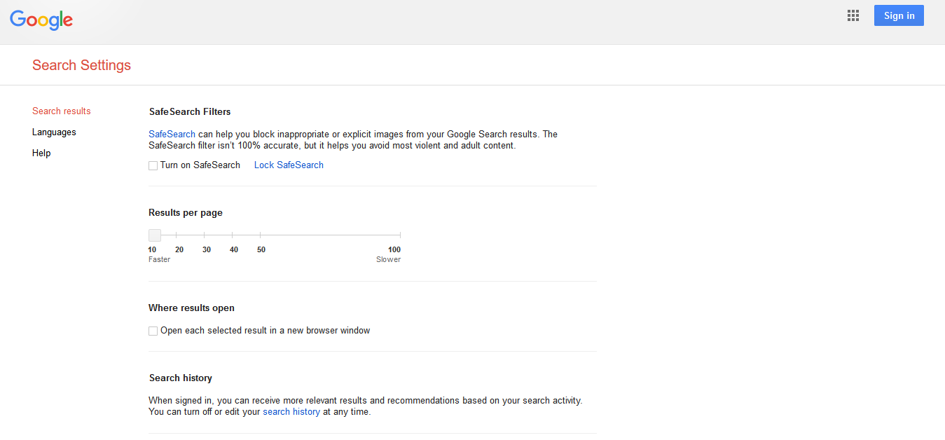
https://www.google.ca/preferences?hl=en

Slide 12
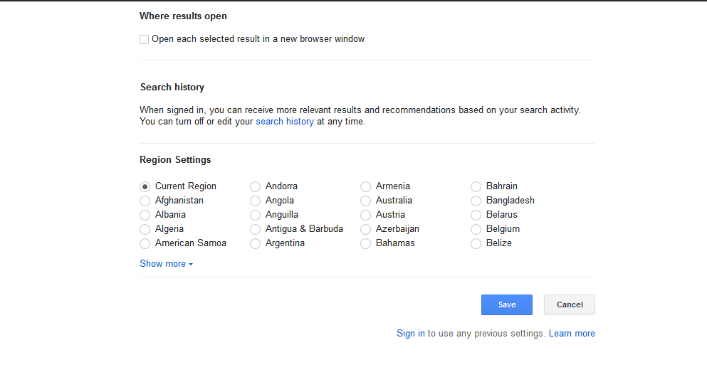

Slide 13
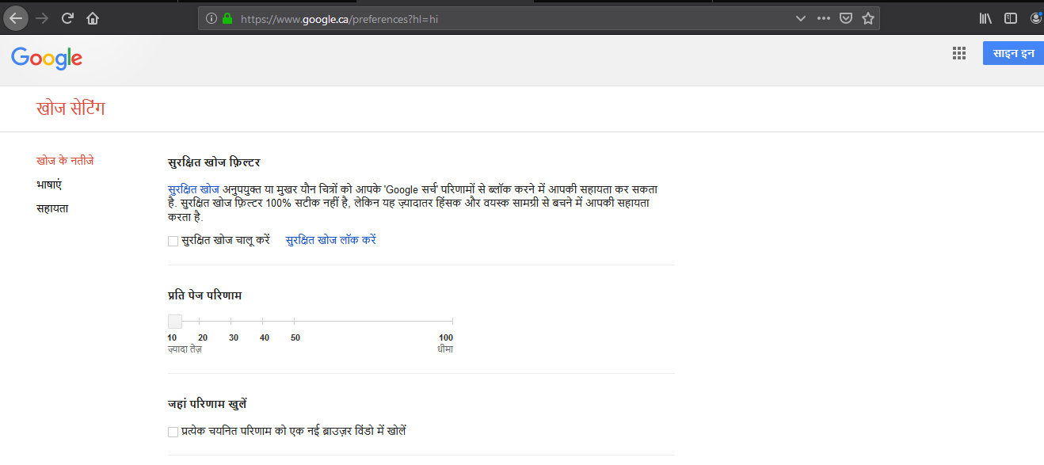

Slide 14
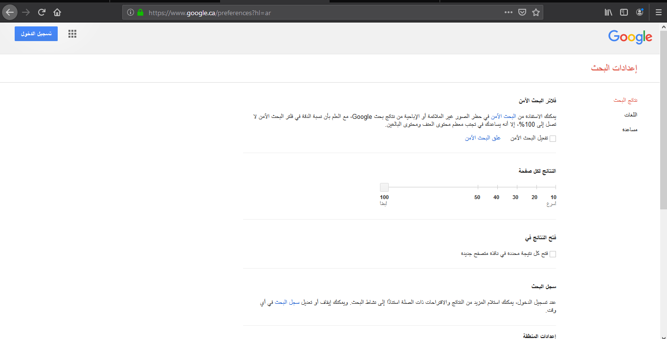

Slide 15
Basic Operators
A+B A-B A|B
1..10 A * C “A B C”
ABC = Variables
+“mahatma” +“gandhi”
+“mahatma” -“gandhi”
+“mahatma” |“gandhi”
+“mahatma gandhi”
+“mahatma” * “gandhi”

Slide 16
Tips
Word limit:- 32
Stop words:- Where, How
Query processing is done from left to right
www.google.com/search?variable1=value1&VA2=VU2
%20=space
%22=”
Intext:password | passcode intext:username | userid | user filetype:csv
Intext:(password | passcode) intext:(username | userid | user) filetype:csv

Slide 17
Advance Search Operator
oprator:SearchTerm or operator:”Search Term” or operator:Search Term
Intitle: | allintitle:
filetype: | allintext:
site: | link:
inanchor: | daterange:
cache: | Info:
related: | phonebook:
rphonebook: | bphonebook:
author: | insubject:
msgid: | group:

Slide 18
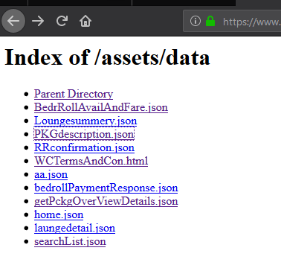
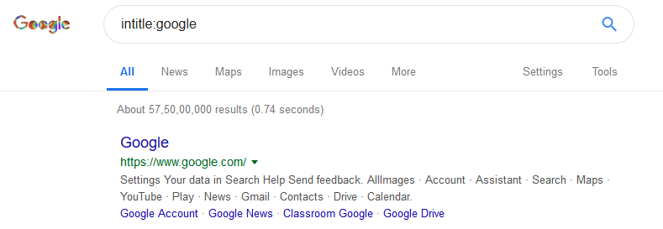
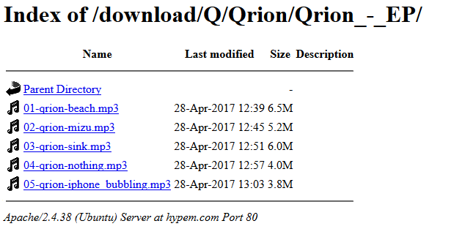
Intitle:google intitle:”index of”

Slide 19
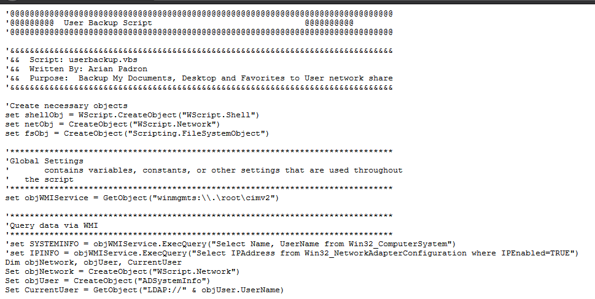
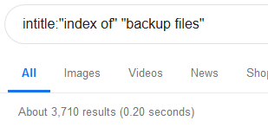
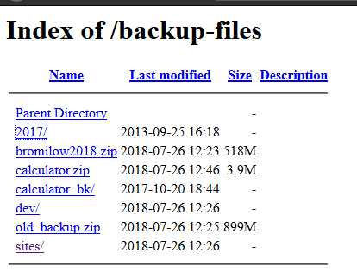
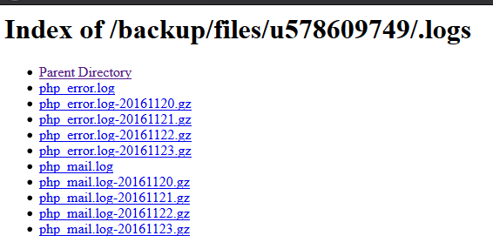
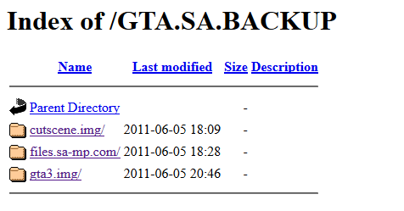
Intitle:”index of” “backup file”

Slide 20
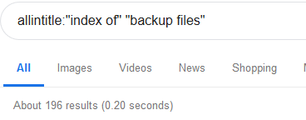
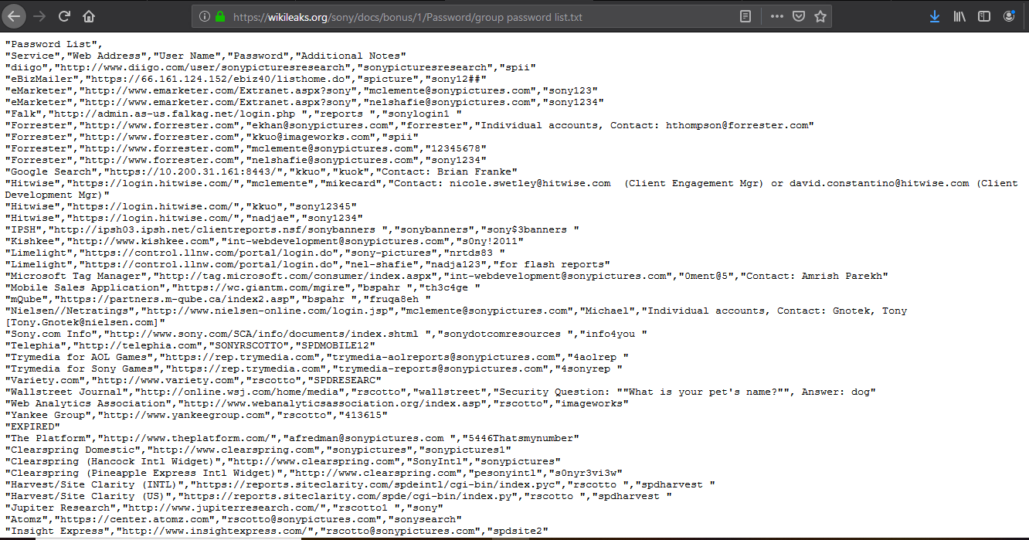

Slide 21
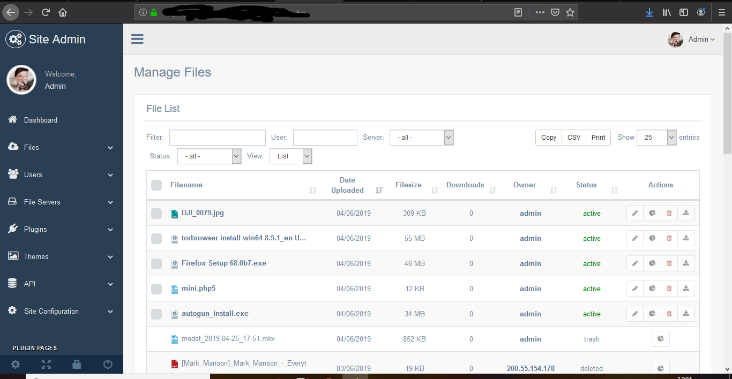
Inurl:admin index

Slide 22
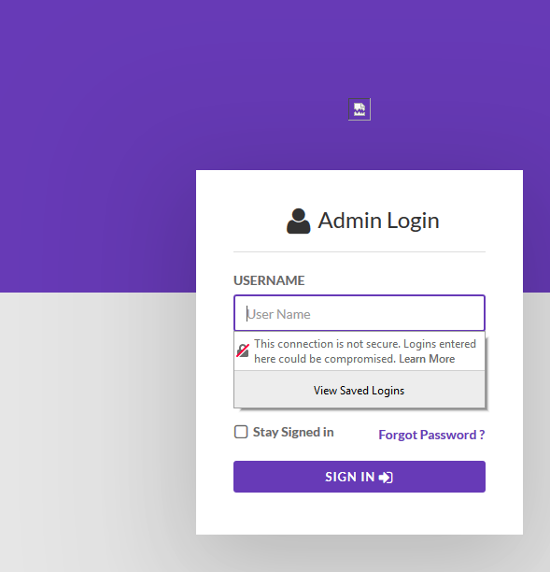
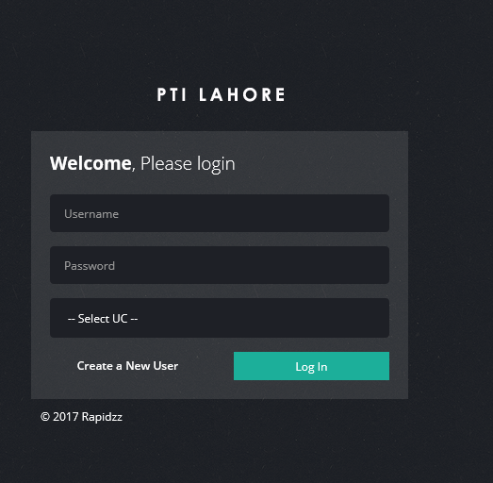

Slide 23
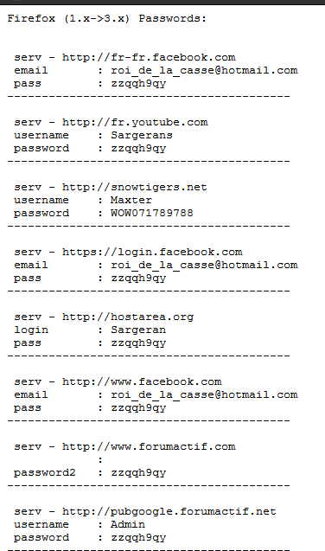
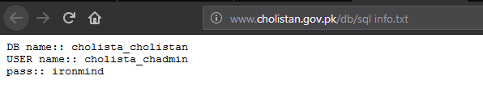
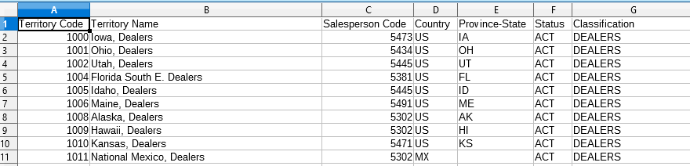

Slide 24
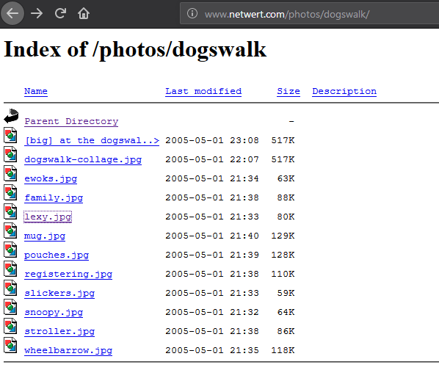
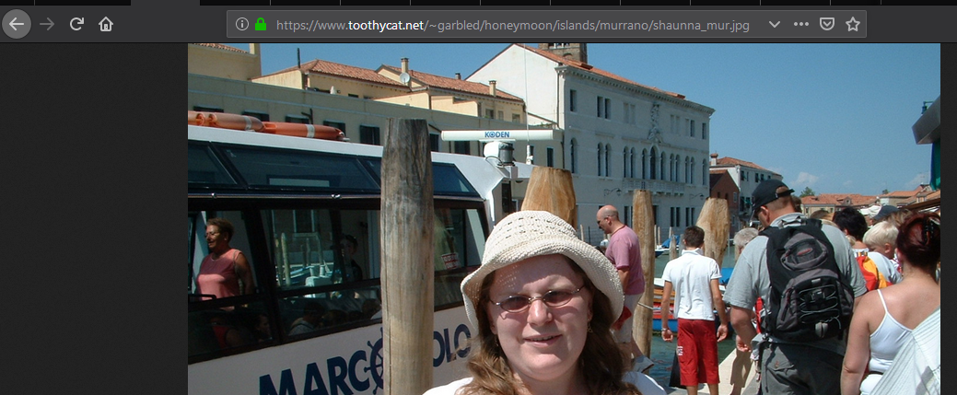
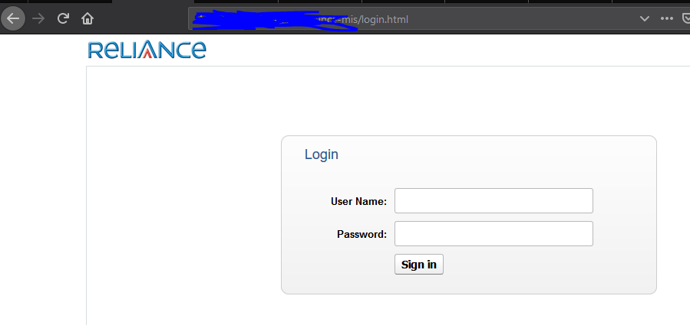
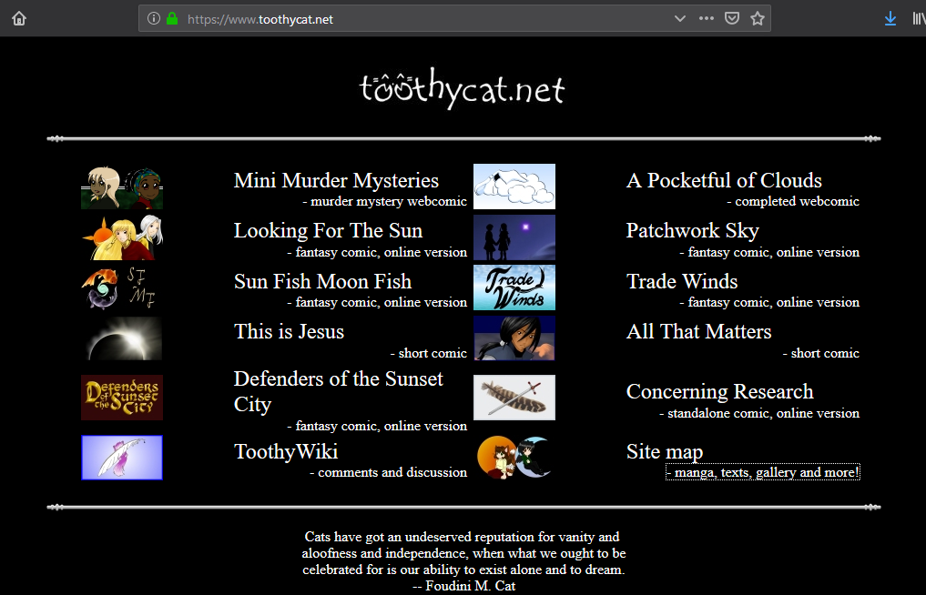

Slide 25
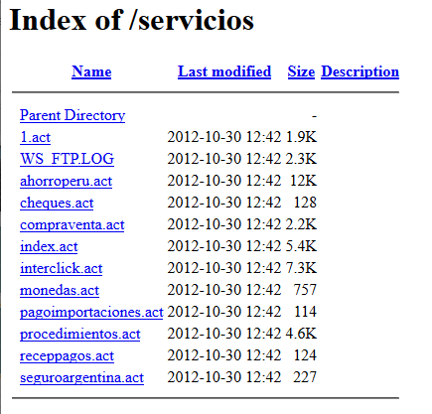
intitle:index.of ws_ftp.log

Slide 26
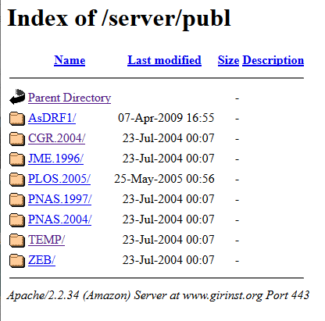
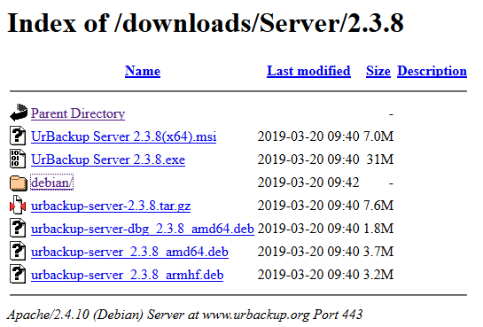
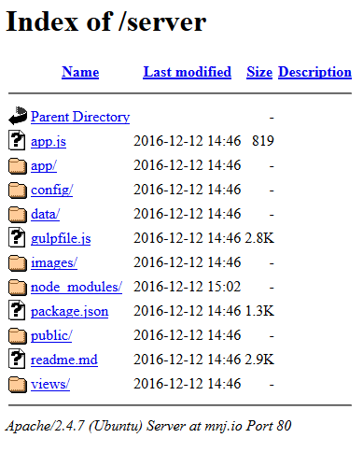
intitle:index.of "server at"

Slide 27
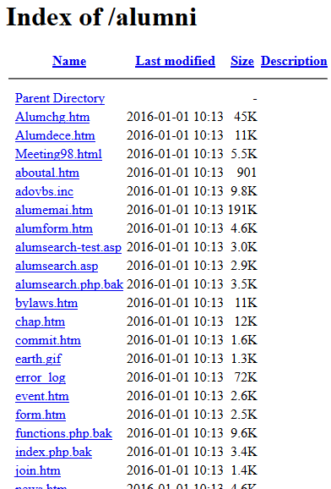
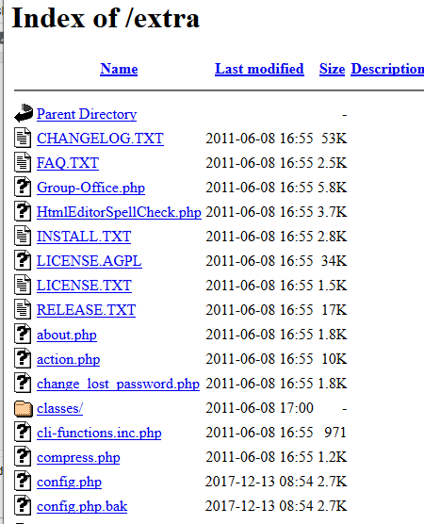
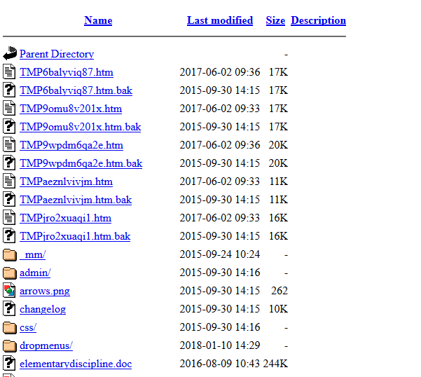
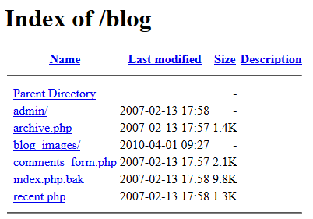
intitle:index.of index.php.bak

Slide 28
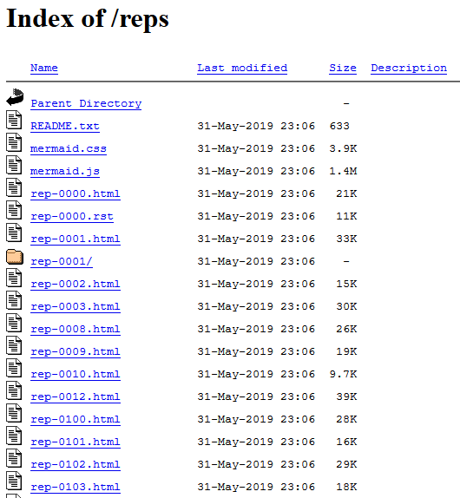
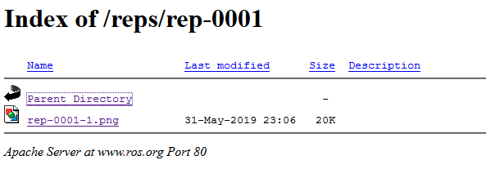
intitle:index.of inurl:0001

Slide 29
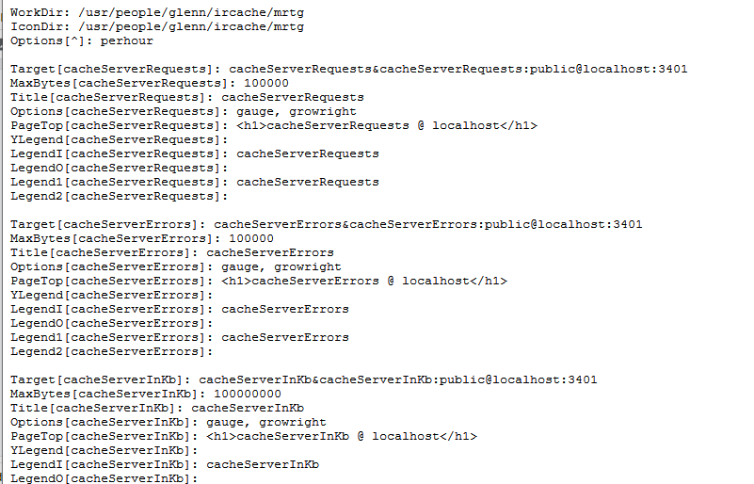
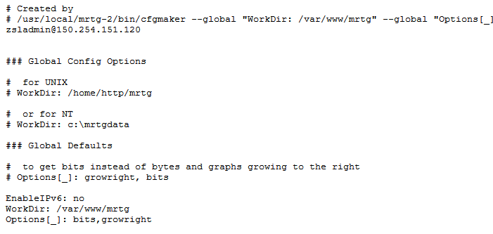
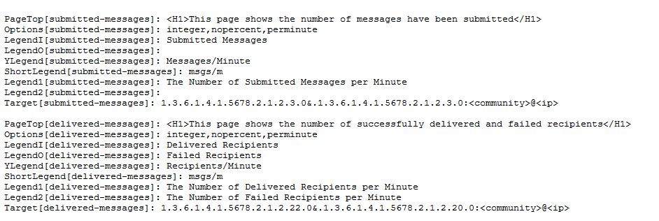
filetype:cfg mrtg "target[*]" -sample -cvs -example

Slide 30
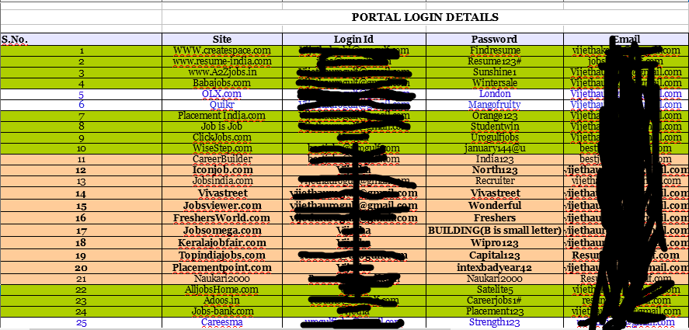
filetype:xls username password email

Slide 31
Information collection framework
abhishek@gmail.com->abhishekatgmaildotcom->”abhishek at gmail dot com”
abhishek@gmail.com->”abhishek gmail com” ->”abhishek@gmail.com”
Steps for email verification:-
$host -t mx gmail.com
$telnet gmail-smtp-in.l.google.com 25
HELO test
abhishekpandey1103@gmail.com
quite

Slide 32
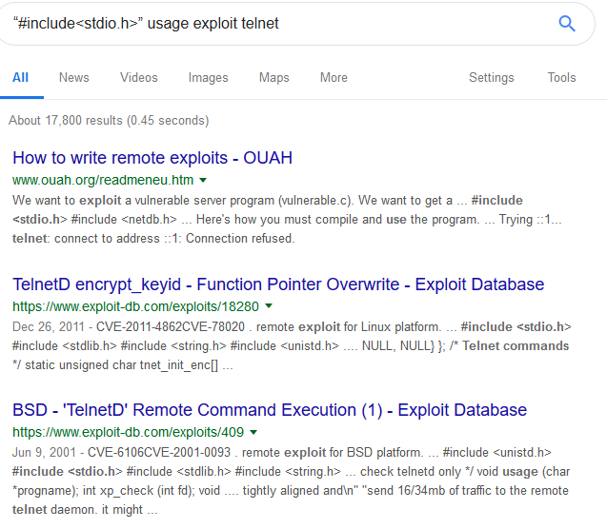
Exploits
“#include<stdio.h>” usage exploit

Slide 33
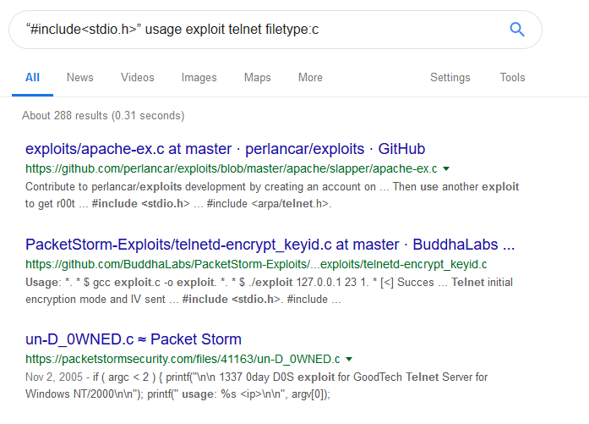

Slide 34
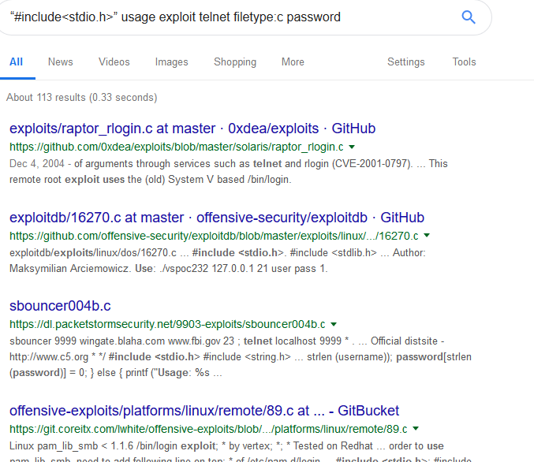

Slide 35
filetype:reg HKEY_CURRENT_USER username
ext:pwd inurl:_vti_pvt inurl:(Service | authors | administrators)
Notes:
Microsoft front page support files

Slide 36
Other things that work:
error | warning | “not found” | “for more information”
login | login
username | userid | employee.id \”your user name is”
password | passcode | ”your password is” reminder forgotten
Inurl:temp | inurl:tmp | inurl:backup | inurl:bak
Intranet | help.desk

Slide 37
?
How to find user id and password of pages that are not written in english language?
https://cse.google.com/

Slide 38
How to prevent this attack
SOFTWARE DEFAULT SETTINGS AND PROGRAMS
A Good Solid Security Policy
Web Server Safeguard
Directory Listings and Missing Index Files
Robots.txt: Preventing Caching
NOARCHIVE: The Cache “Killer”
Password-Protected Mechanisms
WIKTO by Sensepost
Notes:
User-agent:googlebot

Slide 39


Slide 41
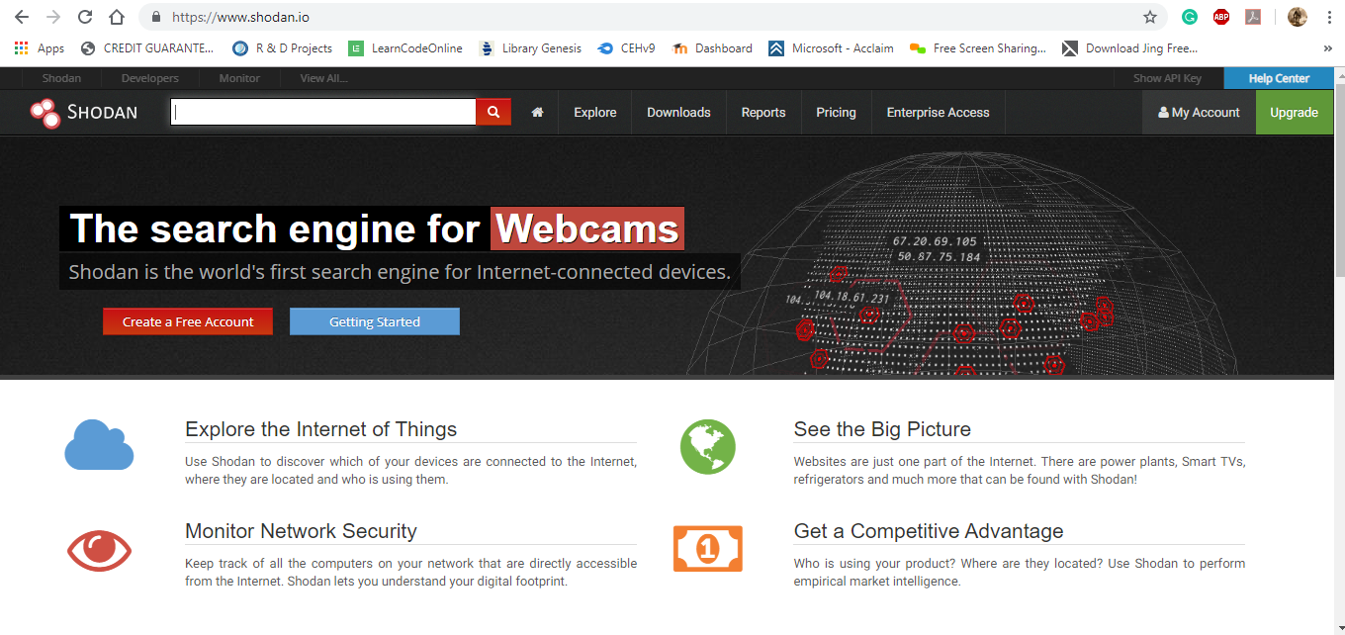

Slide 42


Slide 43



Slide 44
Filters:
city:”City name”
country:”country code”
port:port_number
os:”OS Name”
geo:longitud, latitude
net:ip_or_range
Hostname:host_name
before:DD/MM/YY
after:DD/MM/YY
What you want?

Slide 45


Slide 46


Slide 47


Slide 48


Slide 49


Slide 50

References:
https://www.exploit-db.com/google-hacking-database
ShodanDork GitHub

Slide 51
Future guidance
https://www.exploit-db.com/google-hacking-database
https://github.com/humblelad/Shodan-Dorks
https://github.com/techgaun/github-dorks
https://github.com/gwen001/github-search/blob/master/dorks.txt

Slide 52

Sir. Dinesh O Bareja
All the Participant
Contact:
Pandeyabhishek1103@gmail.com
https://in.linkedin.com/in/abhishekpandey1103

Slide 53


